Slide 1

Polymer
Alaa Hawsawi

Slide 2
Agenda
What’s Polymer?
Angular VS Polymer
Build an Element
Pros and Cons
Who Use Polymer?
How to install it?

Slide 3
What’s Polymer?
The Polymer library is designed to make it easier and faster for developers to create great, reusable components for the modern web.

Slide 4
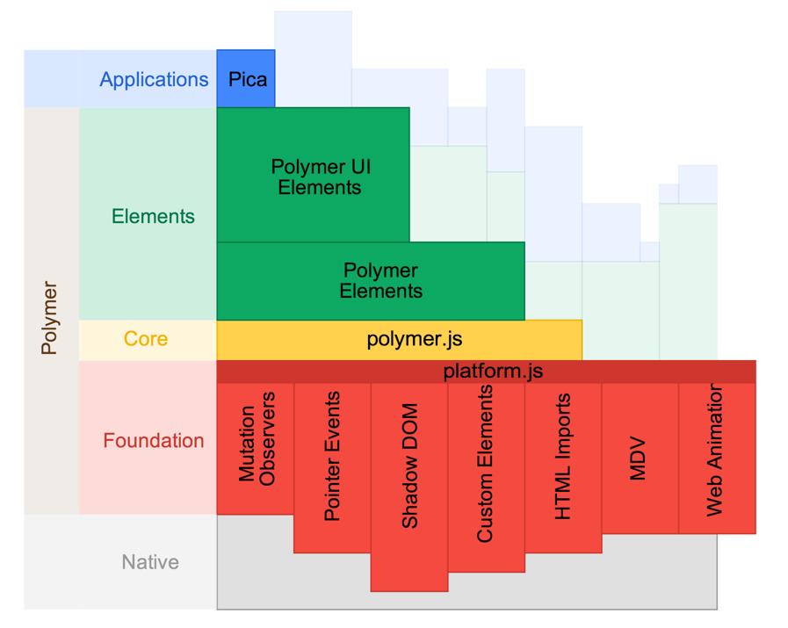
Polymer Architecture
Some info

Slide 5
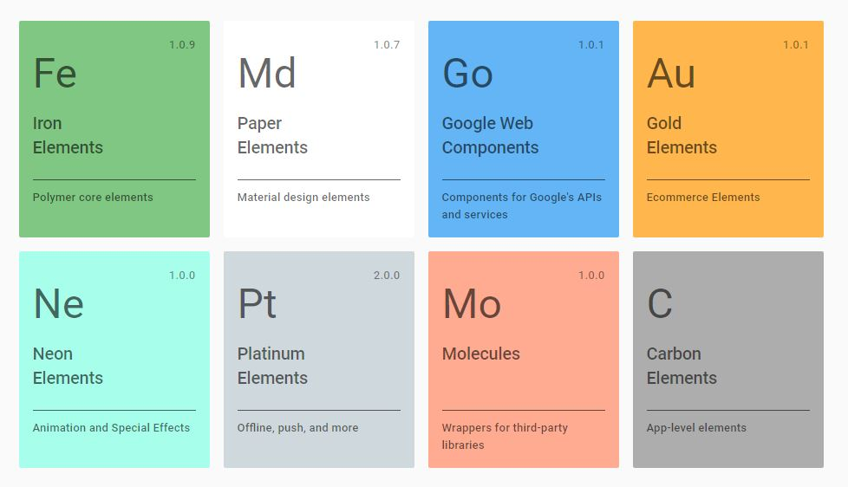
Elements
https://elements.polymer-project.org/

Slide 6
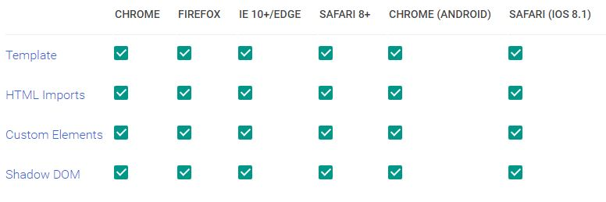
Browser

Slide 7
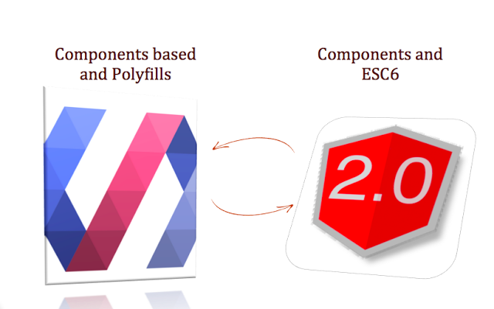
Polymer vs. Angular
Some info

Slide 8
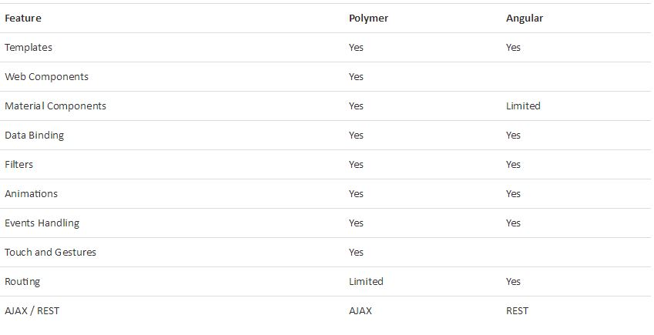
Polymer vs. Angular

Slide 9
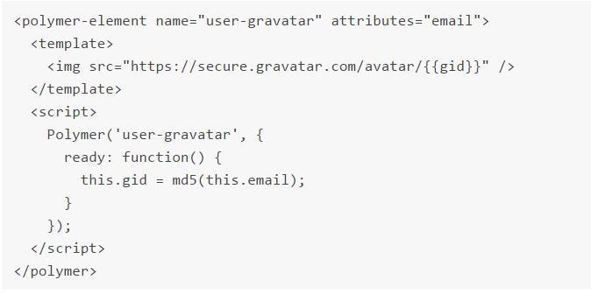
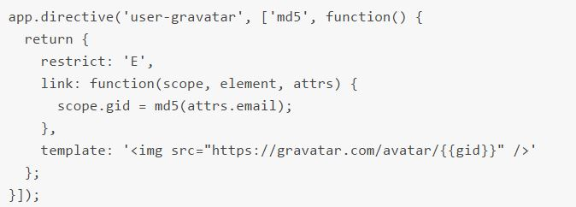

Slide 10

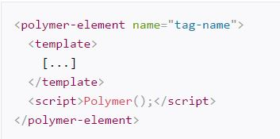
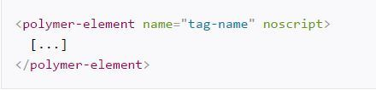
Build an Element

Slide 11
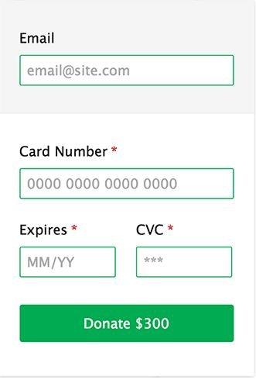
Credit Card Form

Slide 12
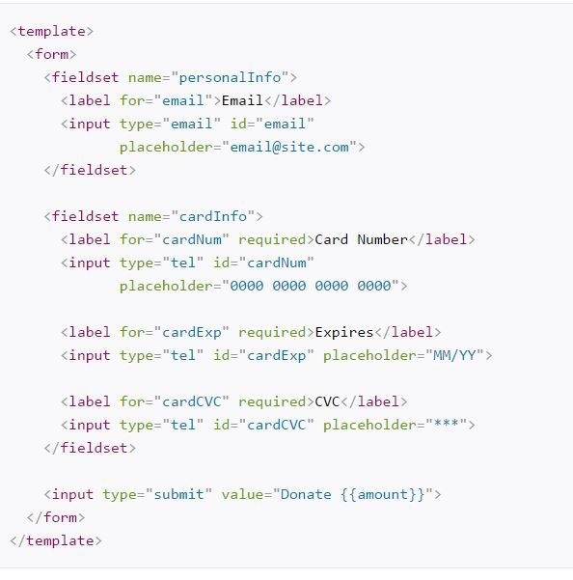
Code 1

Slide 13
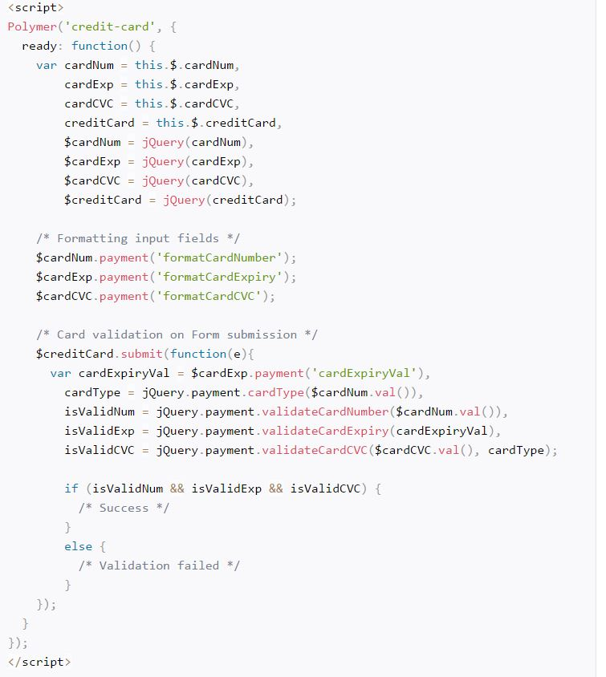

Slide 14




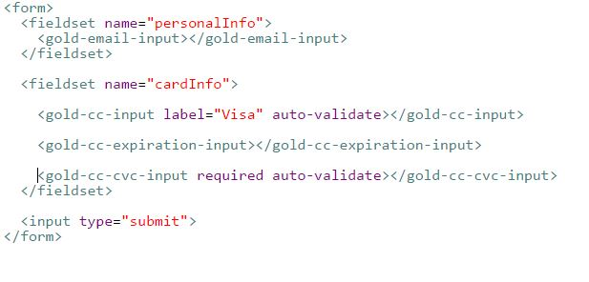
Code 2

Slide 15
Pros
You'll get a chance to create your own components so you'll know how things work within the same component.
You'll make something that people want to see, not something that people can turn away from.
Everything will be contained in elements. Your CSS
You will do less coding in future.

Slide 16
Cons
It’s not entirely clear how to organize larger applications.
It can be slow in performance on mobile because mobile device does not have as powerful JS engine as on web.
Downloading the entire library and polyfills.
Lack of documentation and guidance

Slide 17
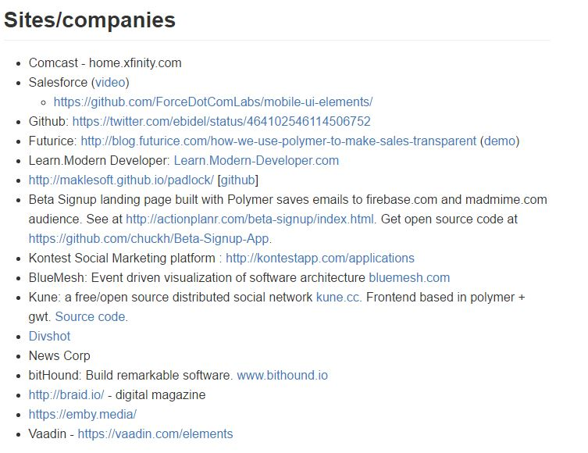
Companies/Sites

Slide 18



How to install it?
Bower
Zip

Slide 19

Sources (list them)
http://www.binpress.com/blog/2014/06/26/polymer-vs-angular/
http://stackoverflow.com/questions/18089075/what-is-the-difference-between-polymer-elements-and-angularjs-directives
https://www.tekkkies.com/google-polymer-element-component-designer-pros-and-cons/
https://www.polymer-project.org/1.0/
http://www.sitepoint.com/building-credit-card-form-custom-element-polymer/

